Slide 1
Shoulder Biomechanics and Total Shoulder Replacement
Prof. Sanjay Gupta
Department of Mechanical Engineering
Indian Institute of Technology Kharagpur

Slide 2
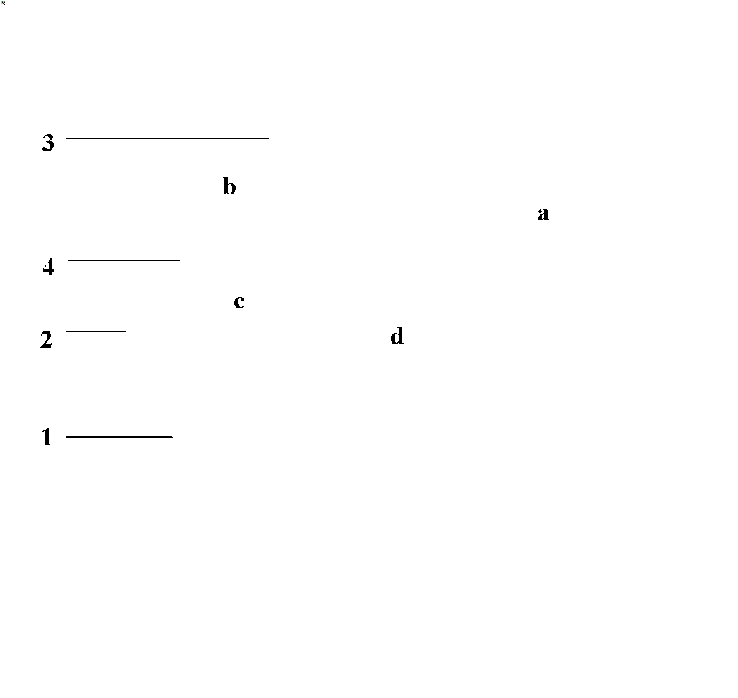
The Shoulder
Humerus; 2. Scapula; 3. Clavicle; 4. Coracoid Process
SternoClavicular (SC) joint;
AcromioClavicular (AC) joint;
GlenoHumeral (GH) joint;
ScapuloThoracic Gliding Plane (STGP).
The normal motions of the shoulder are:
abduction and adduction
flexion and extension
horizontal flexion and extension
exorotation and endorotation

Slide 3
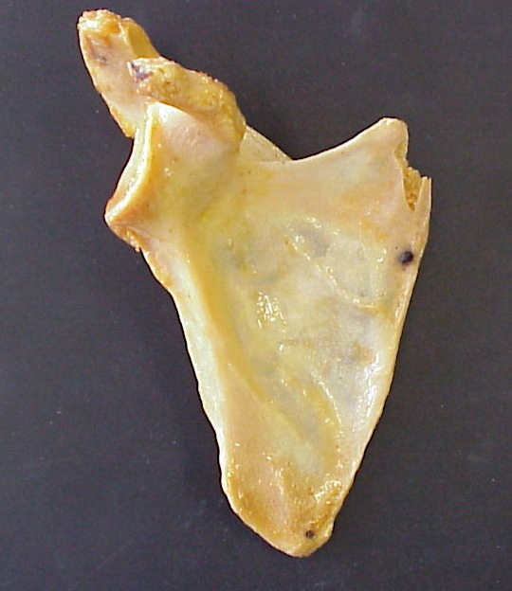
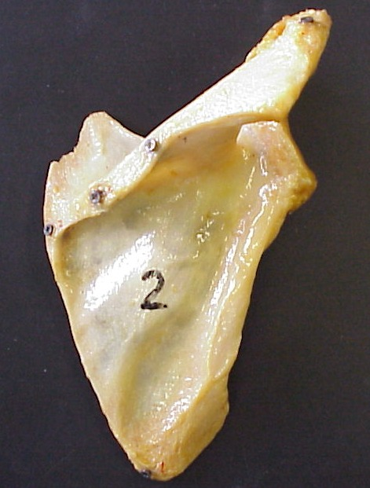
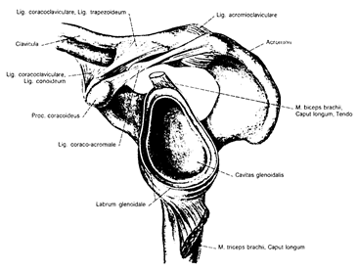
The Scapula
(Ref: Sobotta, 1988)

Slide 4
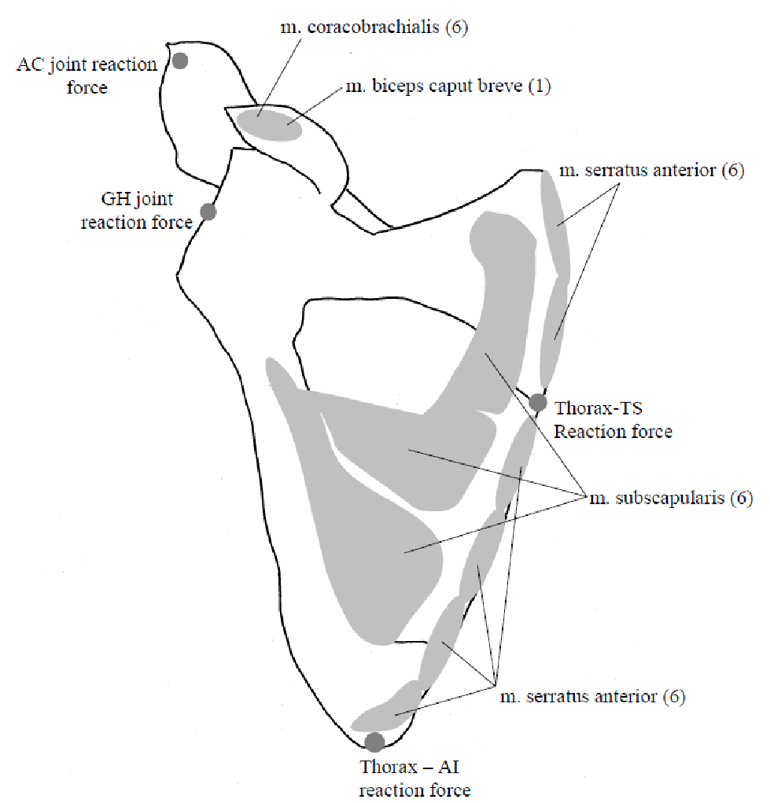
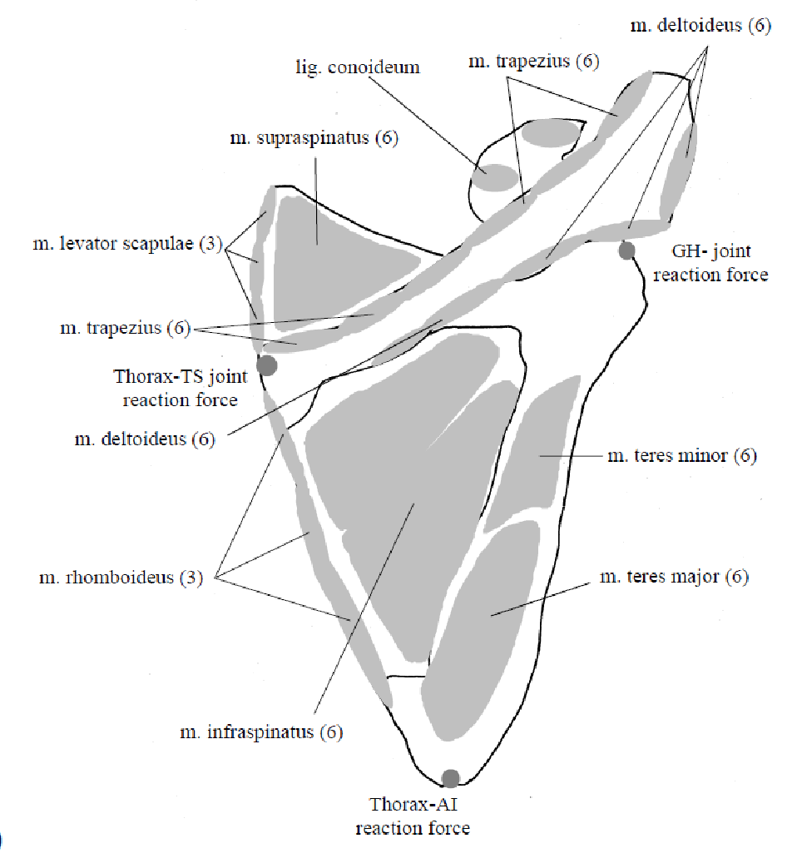
The Scapula
Muscles

Slide 5
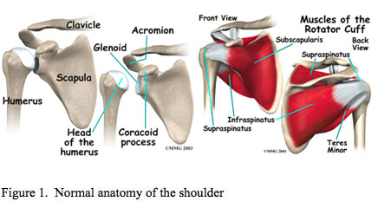
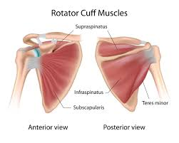
Rotator Cuff
The rotator cuff is a group of tendons and muscles in the shoulder, connecting the upper arm (humerus) to the shoulder blade (scapula). The muscles in the rotator cuff include:
Teres minor
Infraspinatus
Supraspinatus
Subscapularis
Each muscle of the rotator cuff inserts at the scapula, and has a tendon that attaches to the humerus.
These muscles provide rotational stability to the shoulder and allow the shoulder to rotate.
Tears in the tendons of these muscles are called rotator cuff tears. The most commonly affected muscle is the supraspinatus.
‹#›

Slide 6
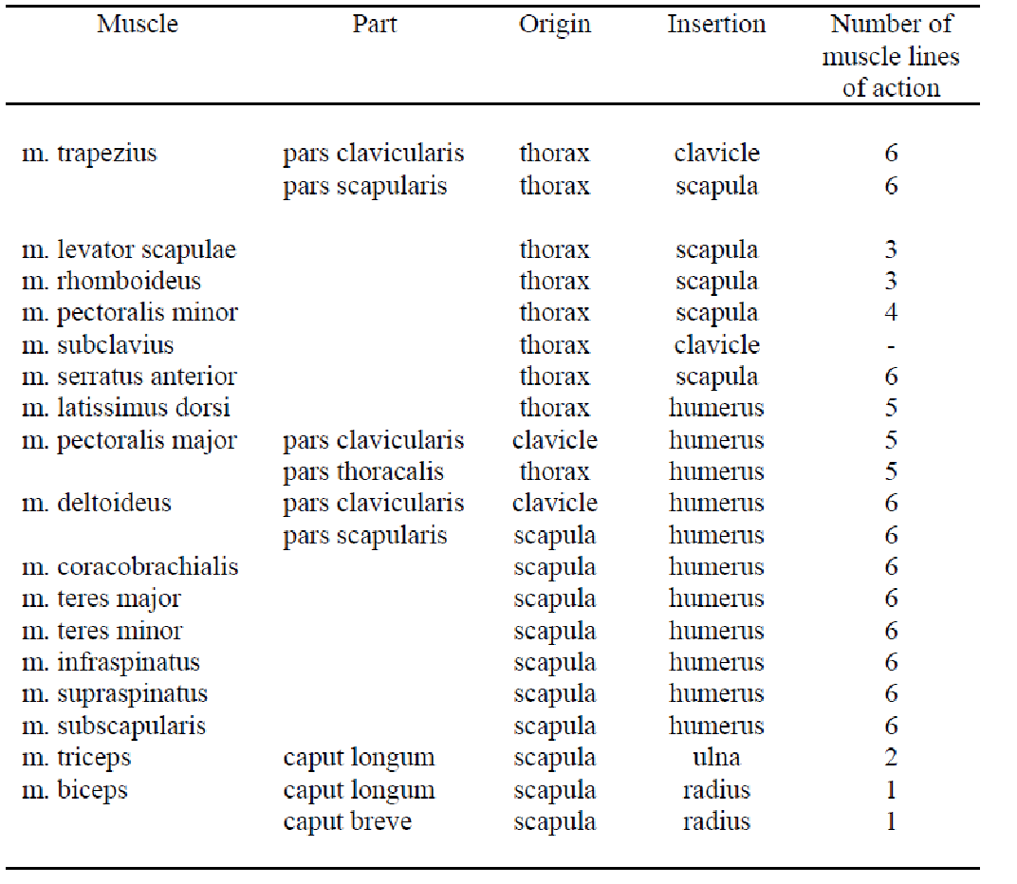
Shoulder Muscles: Origin and Insertation
‹#›

Slide 7
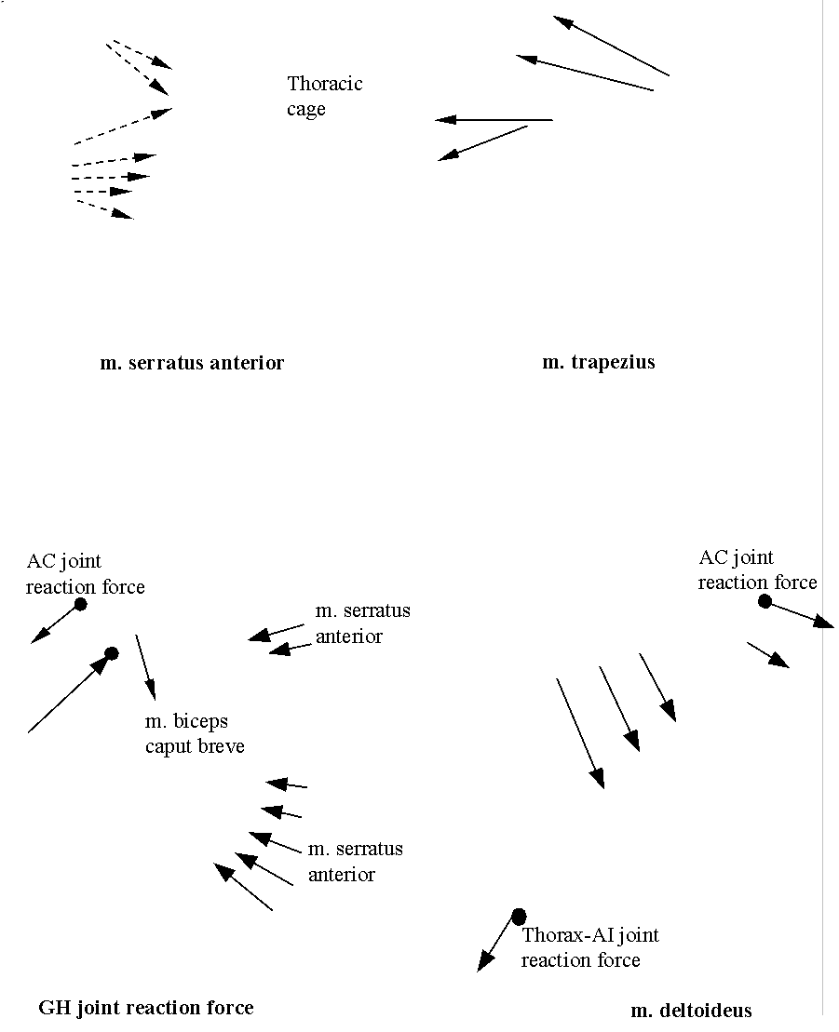
Loading Conditions
The major muscles and joint reaction forces
About 17 muscles are acting on the shoulder joint.
Some of the muscles have large attachment sites
m. serratus anterior
m. trapezius
Van der Helm, F.C.T. (1994ª). Analysis of the kinematic and dynamic behaviour of the shoulder mechanism. J. Biomechanics 27, 527-550.
Van der Helm, F.C.T. (1994^{b}). A finite element musculoskeletal model of the shoulder mechanism. J. Biomechanics 27, 551-569.
GH- joint reaction force
m. deltoideus

Slide 8
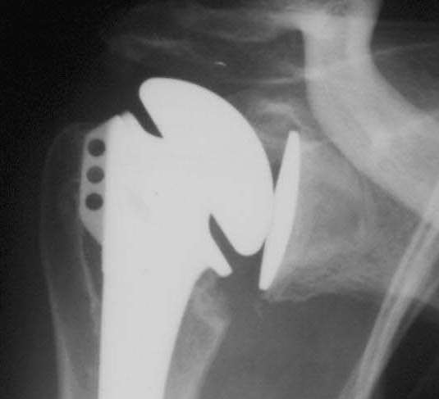
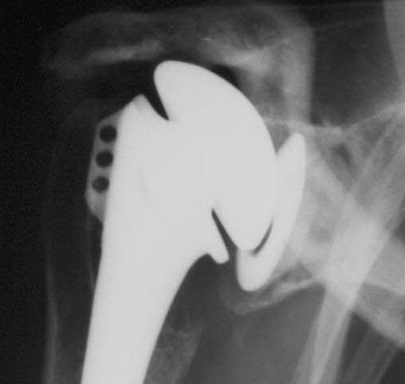
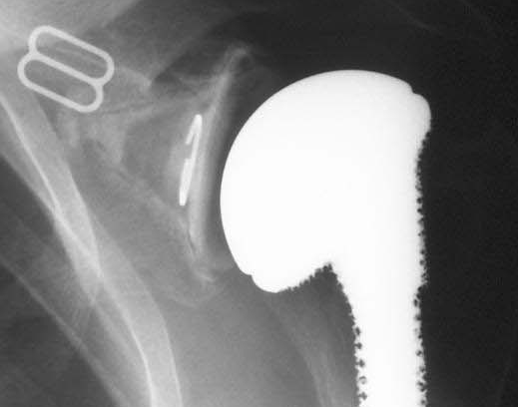
Clinical Relevance
MB
MB
Post-operative (< 1 year)
After 10 years
Shifting of glenoid component
PE
Cemented glenoid components
Cement-bone radiolucencies
After 10 years

Slide 9
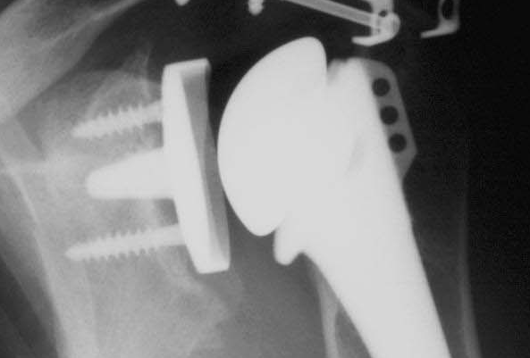
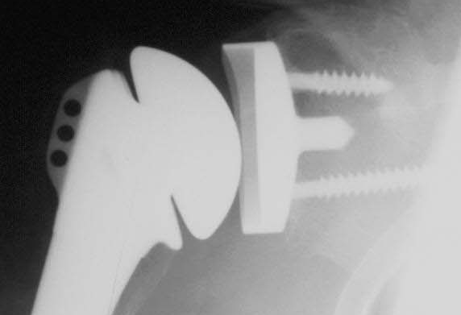
Clinical Relevance
Uncemented glenoid components
UMB
UMB
After 3 years
After 10 years
Stress shielding and bone loss
Normal

Slide 10
Motivation
Clinical and radiographic studies indicate glenoid component loosening as the most-frequently-occurring problem in the Total Shoulder Arthroplasty (TSA).
The precise relationship between the cause and the effect regarding mechanical loosening requires a Three-Dimensional (3-D) Finite Element (FE) study using Computed Tomography (CT) scan data.

Slide 11
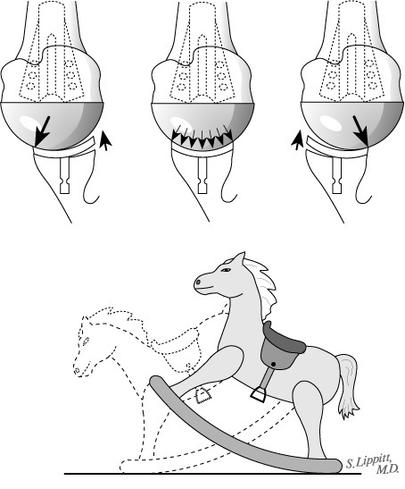
Rocking Horse Effect
‹#›

Slide 12
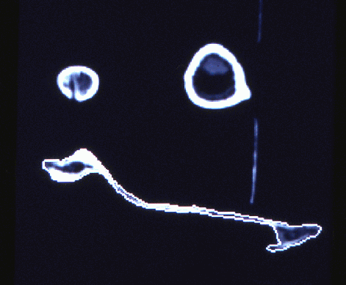
CT-scan slice of shoulder
Humerus
Clavicle
Scapula

Slide 13
Objective
Before analysing a prosthetic joint, it is important:
to evaluate the stress distribution in the natural scapula acted upon by all the muscles, ligaments and joint reaction forces.
to develop a realistic 3-D Finite Element model using CT-scan data.

Slide 14
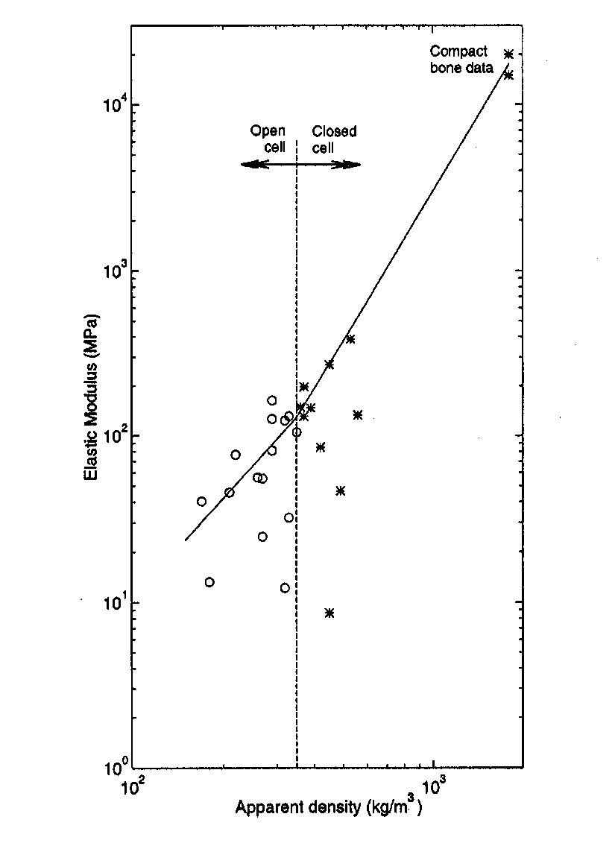
Geometry & Material Properties
Contour data from CT slices
(layer reconstruction)
Apparent density vs. CT- gray value
(linear calibration)
Elastic modulus vs. apparent density
(power law)

Slide 15
The 3-D FE model of the scapula
Elements: 10921
Nodes: 14086
DOF: 63435

Slide 16
Results
90-degrees abduction of the arm
Principal Stress
(MPa)
Principal Stress
(MPa)
0
0
Scapula
Scapula

Slide 17
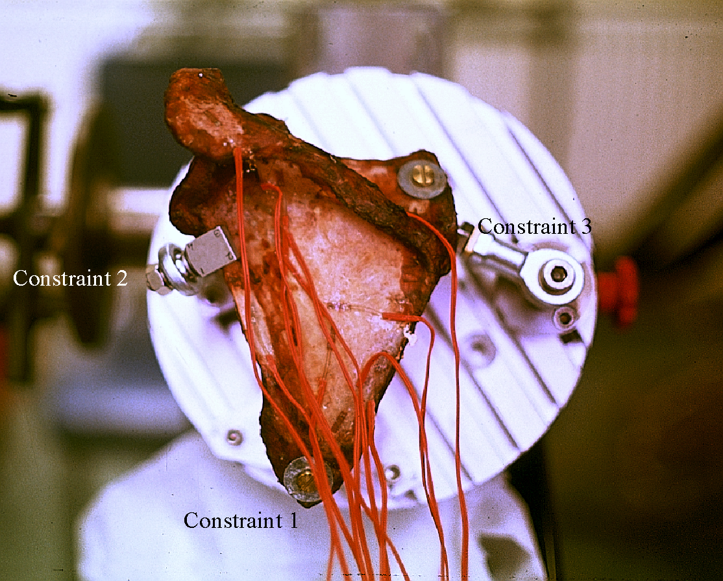
The Experimental Set-up

Slide 18
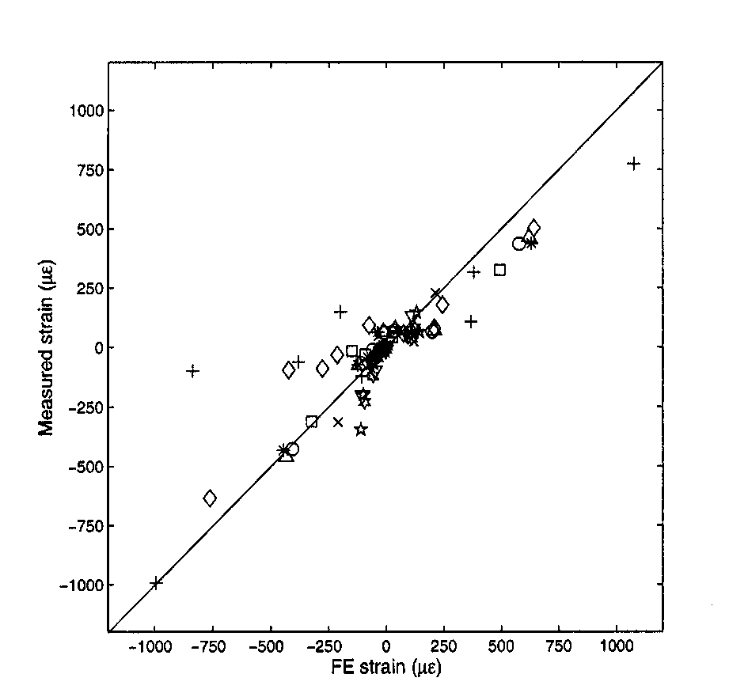
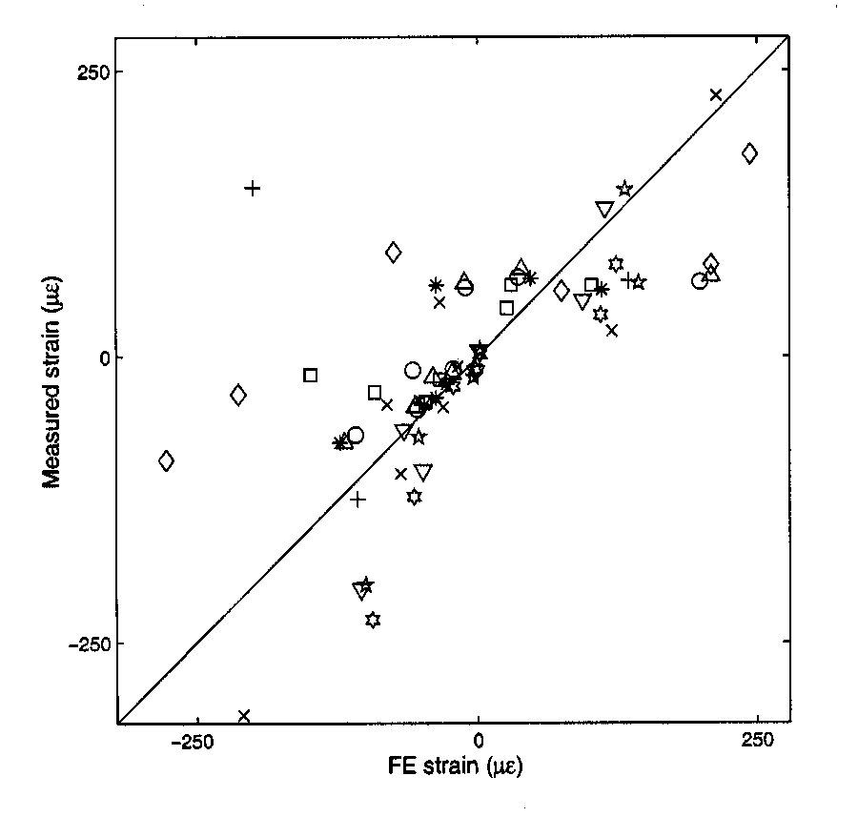
Measured strain vs. FE strain
Correlation coefficient: 0.89 – 0.97
Standard error: 29 – 105 με
Percentage error in slope: 9 – 23%

Slide 19
Findings
An accurate moderately sized 3-D FE model of the scapula has been obtained, using shell-solid modelling approach and CT-scan data.
High stresses (tensile & compressive) are generated on either sides of the lateral border, scapular spine and acromion, indicating bending.
Stresses are low in the fossa areas, which indicate that the function of these areas is to act as attachment sites for large muscles.
The FE model along with the static shoulder model of forces is useful for calculating stress distribution in various parts of the scapula during movements of the arm.

Slide 20
Objective
To evaluate stress distributions
in the implant and in the bone
at the material interfaces
with regard to the common failure scenarios, using 3-D FE models of cemented and uncemented glenoid prostheses.

Slide 21
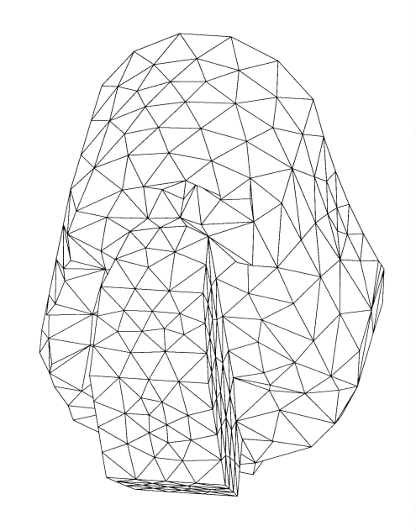
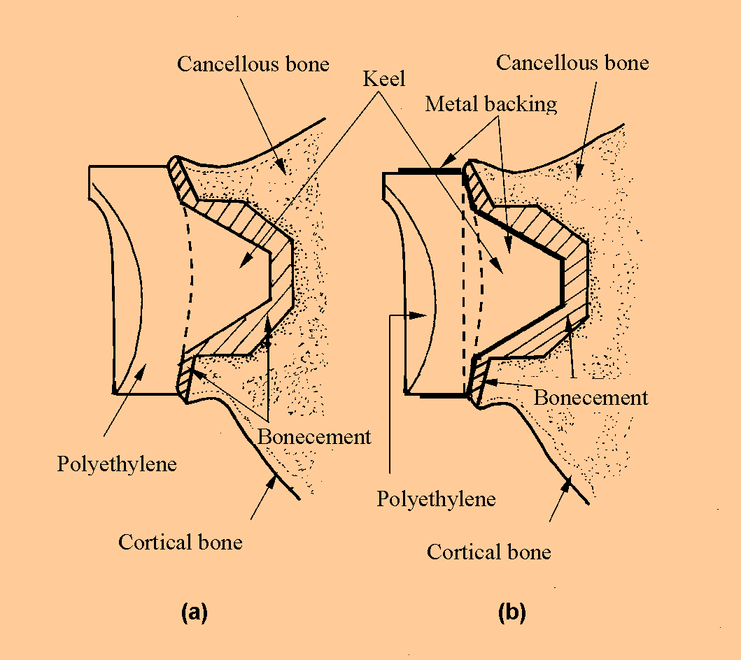
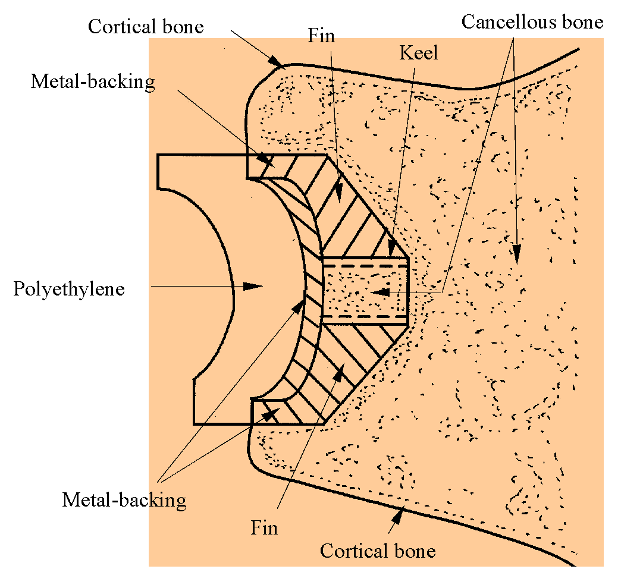
The Glenoid Prostheses
Cemented
Uncemented

Slide 22
The Submodelling Technique
Overall model of the scapula
Sub-model with the glenoid prosthesis

Slide 23
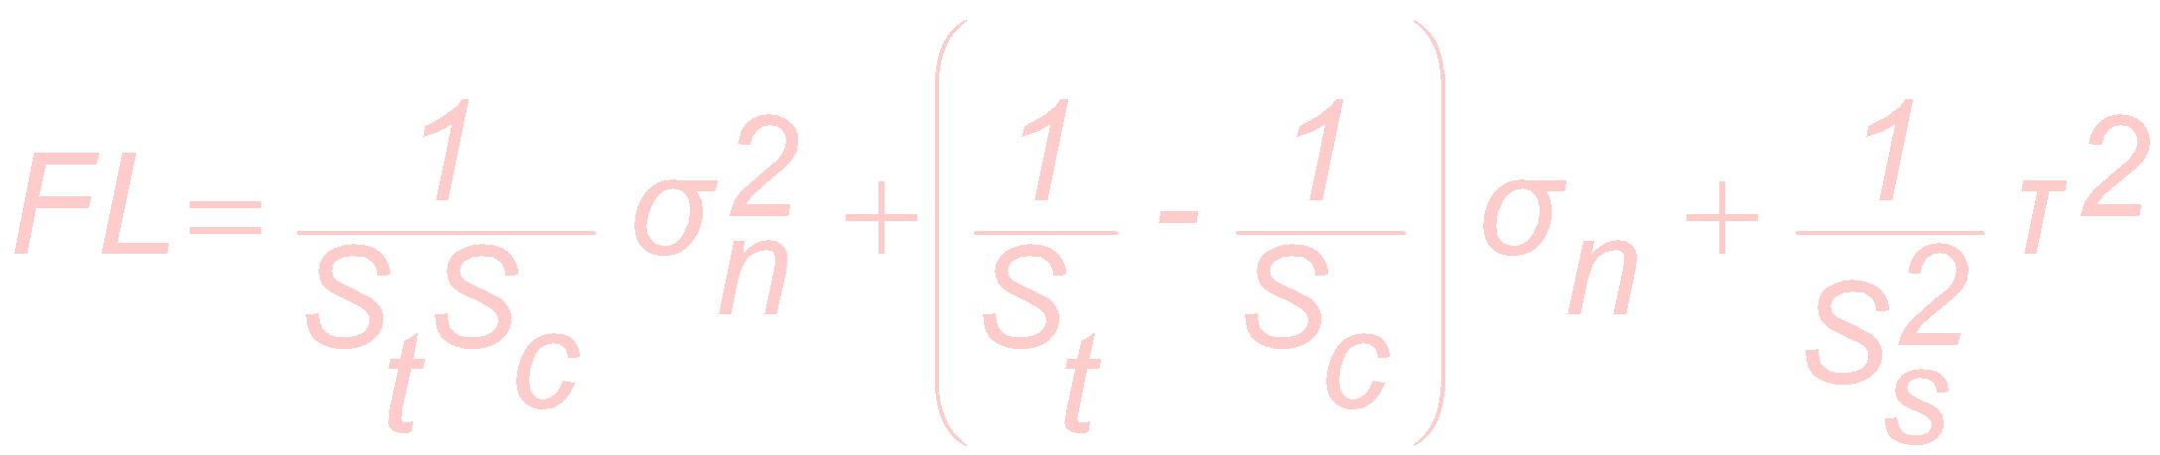
Interface stresses
Hoffman’s Failure Criterion
S_{t} = 14.5 ρ ^{1.71} Kaplan et al. (1985): J. Biomech
S_{c} = 32.4 ρ ^{1.85} Kaplan et al. (1985): J. Biomech
S_{s} = 21.6 ρ ^{1.65} Stone et al. (1983): J. Biomech
FL < 1 secure, less likely to fail.
FL > = 1 more likely to fail.

Slide 24
Results
90-degrees abduction of the arm
Principal Stress
(MPa)
Principal Stress
(MPa)
0
0
Total Polyethylene
Metal-backed Polyethylene

Slide 25
Results
ANSYS 5.0 A
FEB 9 1998
22:08:34
PLOT NO. 1
NODAL SOLUTION
STEP=4
SUB =1
TIME=4
SEQV (AVG)
TOP
DMX =4.273
SMN =0.01245
SMX =39.093
SMXB=73.787

Slide 26
Conclusions
Total PE provide a more physiological stress distributions than the MB design.
For total PE design, the cement-bone interface adjacent to the tip of the keel appears very likely to fail (FL= 1.86) as compared to the superior edge of the prosthesis (FL= 0.19), although stresses are not significantly lower around the superior edge.
For MB design, the cement-bone interface adjacent to the tip of the keel appears very likely to fail (FL= 2.16) as compared to the superior edge of the prosthesis (FL= 0.68).
The implant-cement interface stresses are higher for MB design as compared to the total PE design.

Slide 27
Conclusions
A part of the subchondral bone along the superior-inferior direction of the glenoid should be preserved in order to strengthen the glenoid.
The cancellous bone, underlying the uncemented prosthesis is subject to lower stresses as compared to the cemented designs, which might result in stress shielding.
The implant-bone interface, for the uncemented design appears less probable to fail (FL= 0.84) as compared to the cemented prostheses, since higher interface bond strength is offered.

Slide 28
~ Thank you for listening ~

